Slide 1
Will it be YOUR next step?

Slide 2
So, who are we?
We are one of Scotland’s largest colleges of further and higher education.
Last year we welcomed 7,000 full-time students and around 11,000 part-time students.
Campuses in Aberdeen City, Altens, and Fraserburgh.

Slide 3
Why NESCol?
A wide range of courses
Excellent facilities across campuses
Great links with schools, universities and employers, with clear progression routes

Slide 4
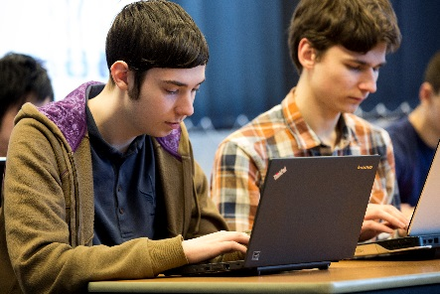
College vs. School
What’s the difference?
Continuous assessment
Different start and finish times
Most courses around 18 hours per week actual attendance
Meet with people from all ages and backgrounds
Social life – student discounts.

Slide 5
Student Support
Guidance Tutor
Student Funding Advisers
Careers Advisers
Learning Development Centre.

Slide 6
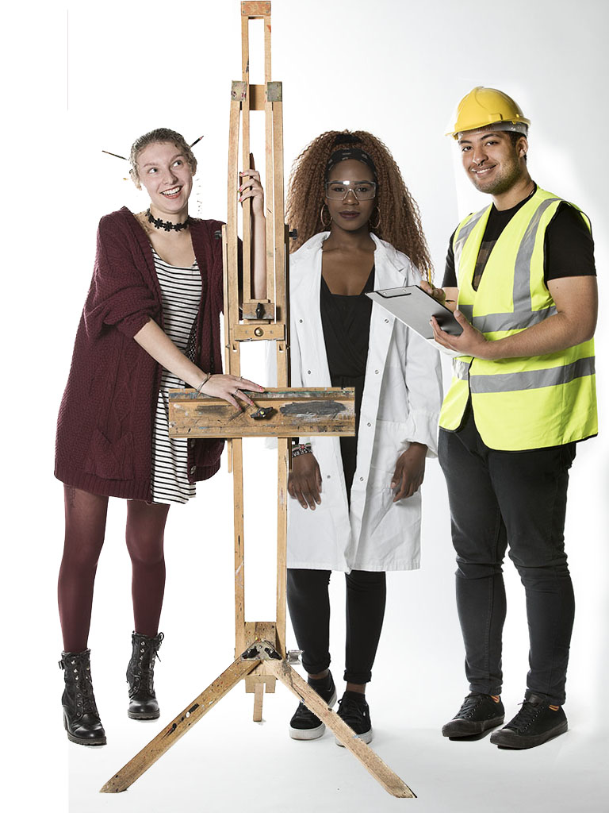
Courses – which one for you?
Art & Design
Automotive and Construction
Business & Management
Care
Computing
Engineering
ESOL
Hairdressing, Beauty & Complementary Therapies
Highers & Intermediate 2 (SQA)
Music, Drama & Creative Media
Professional Cookery & Hospitality
Science
Social Sciences
Sport & Fitness
Tourism & Events.

Slide 7
Progression
on up!
University
North East Scotland College can be a great stepping stone for those who don’t feel ready for university when they leave school.
NESCol has formal articulation with 8 universities across Scotland:
Robert Gordon University
The University of Aberdeen
Abertay University
Edinburgh Napier University
University of the Highlands and Islands
Glasgow Caledonian University
The Open University
Queen Margaret University.

Slide 8
Progression Example
on up!
Higher Education: how can you progress?

Slide 9
Degree Link on up!
What’s in it for me?
Smaller class sizes in your first 2 years
More one on one time with lecturers
More hands on experience with equipment
Learn practically and in work-like environments
More time to prepare for the next step
NESCol has entry points for all qualifications
Associate Student Scheme
Degree Prep

Slide 10
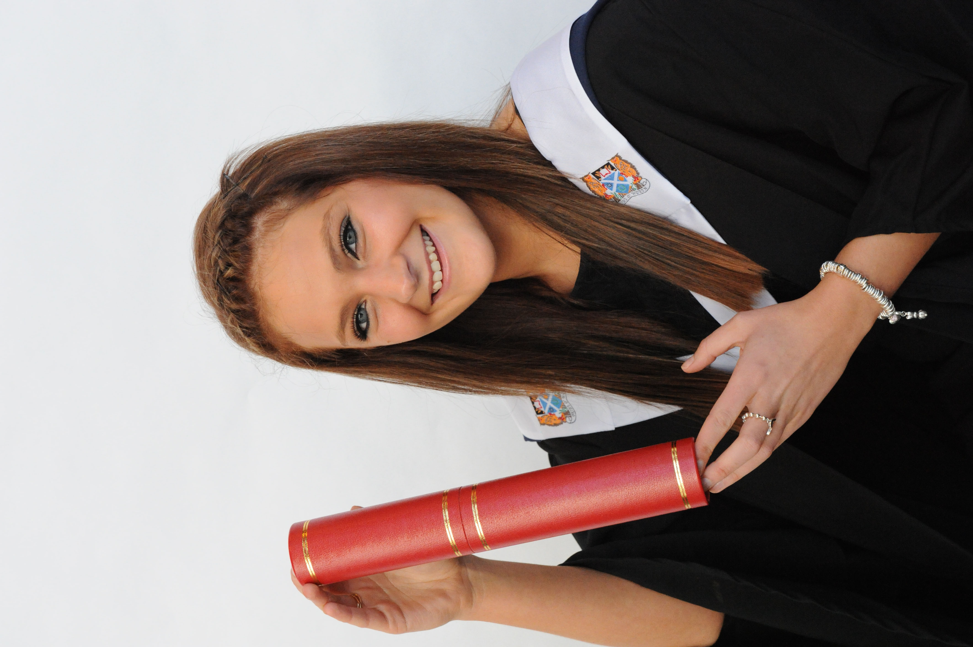
Philippa
Studied HND Sports Coaching and Development at NESCol.
Used Degree Link to secure a place in 3rd year at RGU and graduated with a Bachelor of Science.
Now an assistant PE teacher at a private school in Aberdeen.
“I looked into courses at college which offered progressive routes in the sporting environment. I was successful in gaining a place on the HND Sports Coaching and Development course. This course had a 2 + 2 link with Robert Gordon University. During college I was able to gain numerous coaching awards, carry out several placements relating to different fields – not just teaching – and expand on knowledge already gained.”

Slide 11
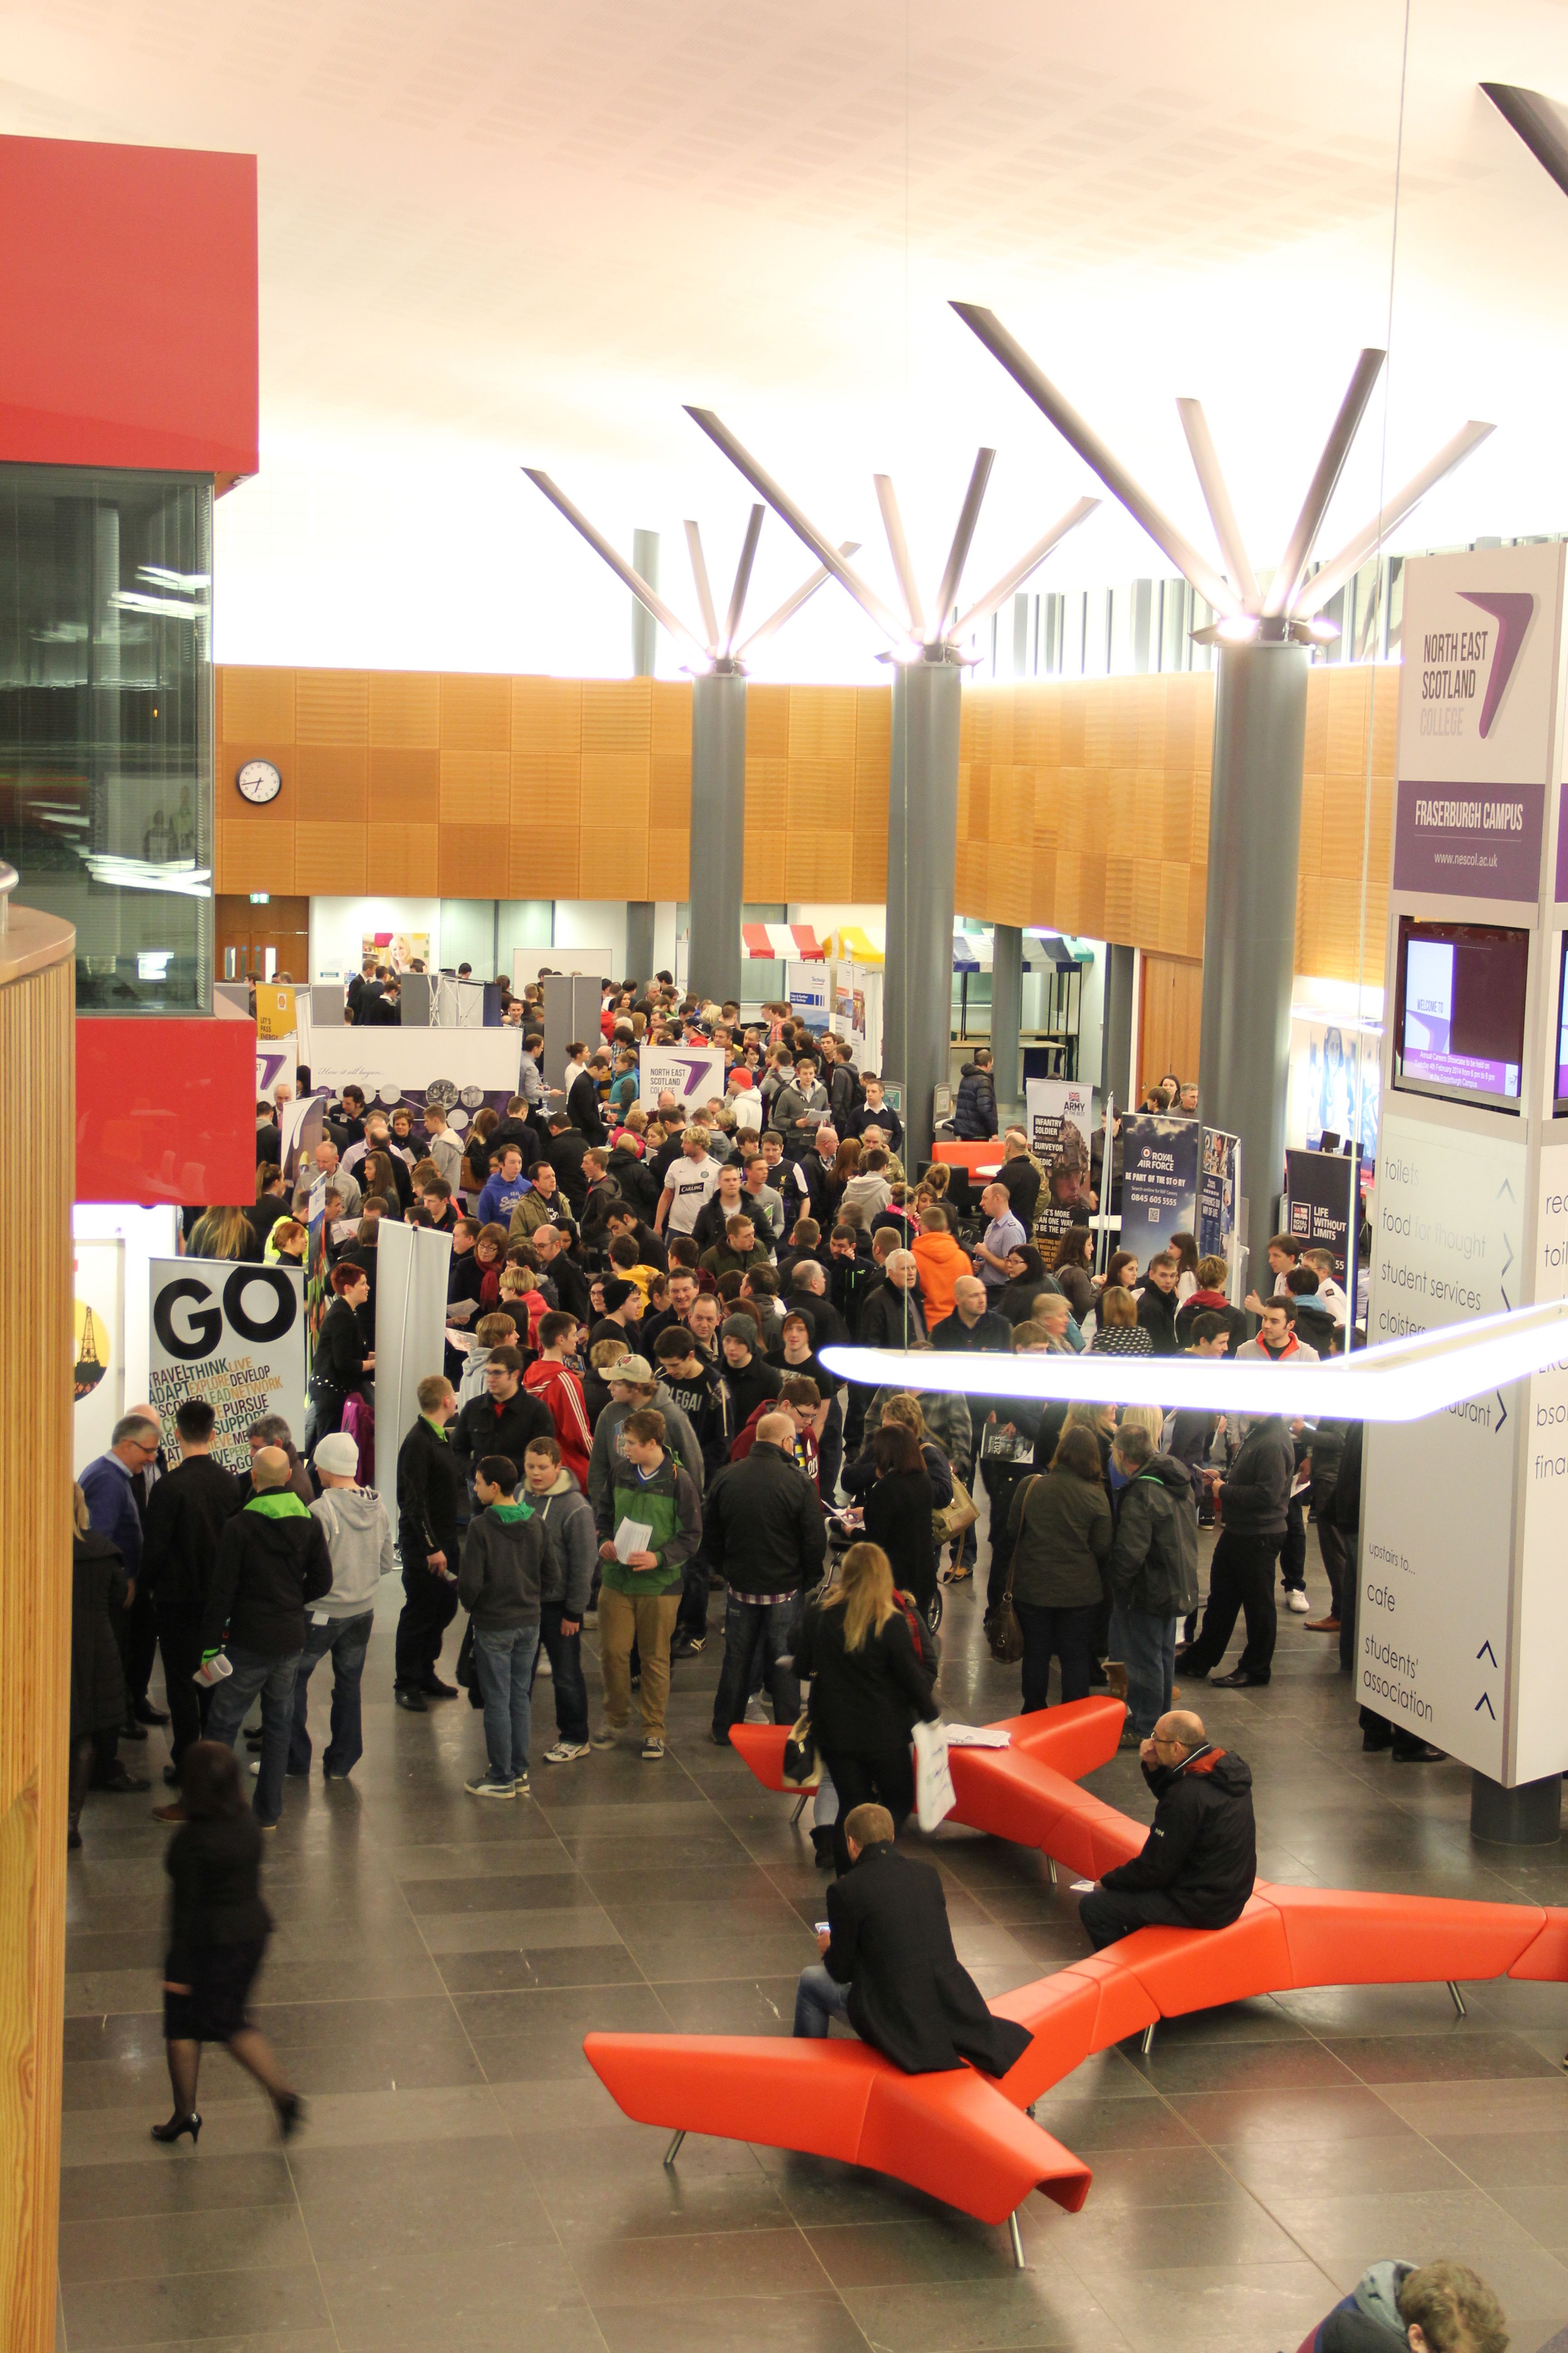
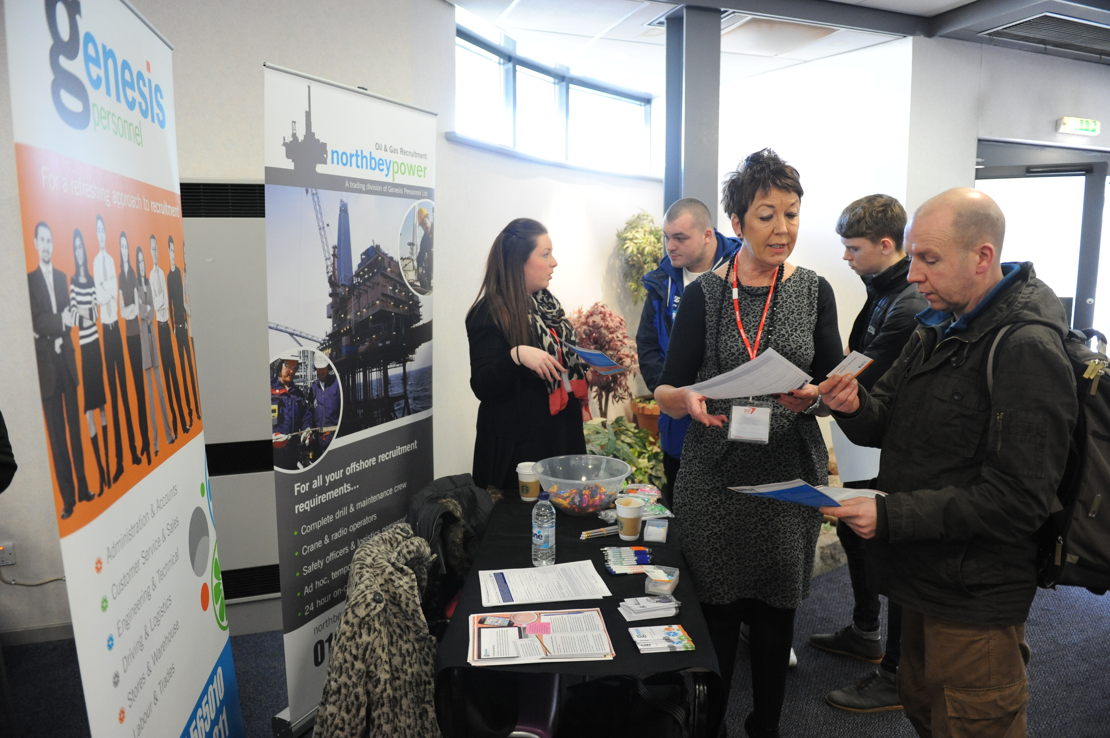
Progression
on up!
Employment
Placements
Work experience through learning
Careers Events and Employer Links
CV workshops
Careers advice.

Slide 12
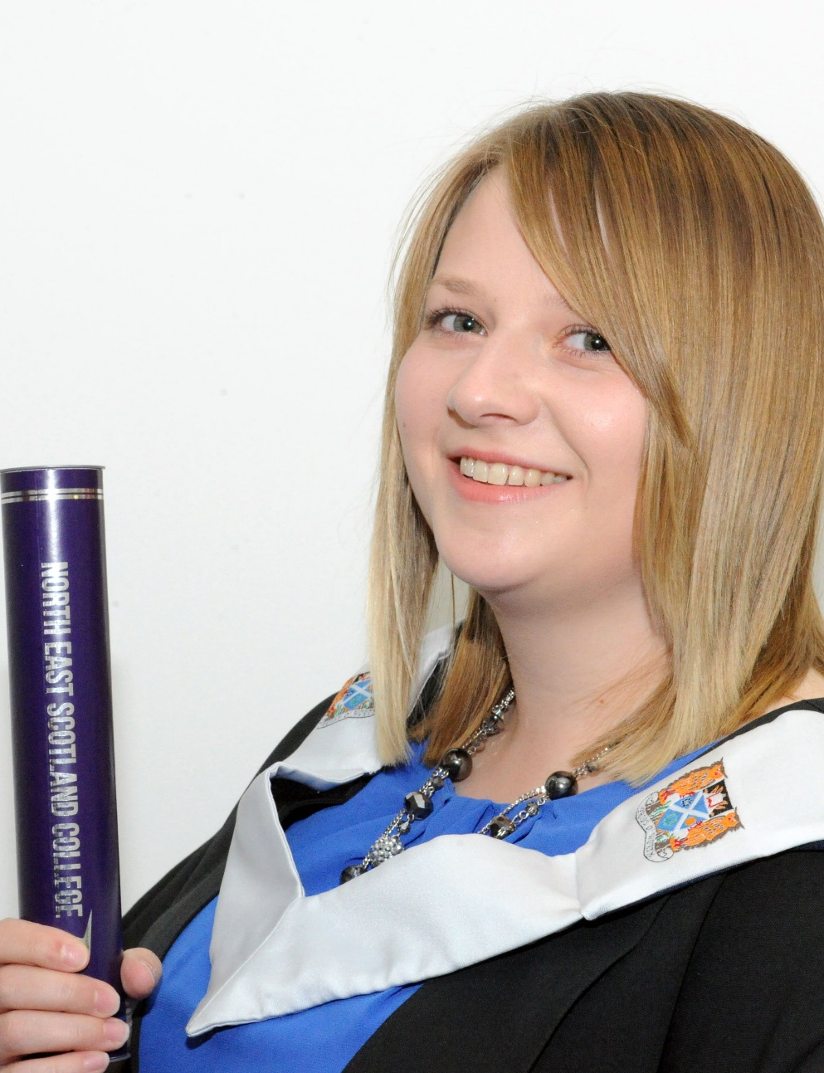
Janey
Studied HND Mechanical Engineering
Carried out work placement during College
Now working as a Marine Draughstman at Macduff Shipyards
“The job is really interesting working with different companies from all over the world to design bespoke boats. I had a great time at College and am so grateful that studying there has allowed me to go straight into a job I enjoy.”

Slide 13
Think North East Scotland College is for you?

Slide 14
Open Days
Come along to see around our campuses and meet our lecturers.
Fraserburgh Campus: Thursday, 1 March, 4pm-7pm
Aberdeen City and Altens Campuses: Saturday, 10 March, 10am-2pm.

Slide 15
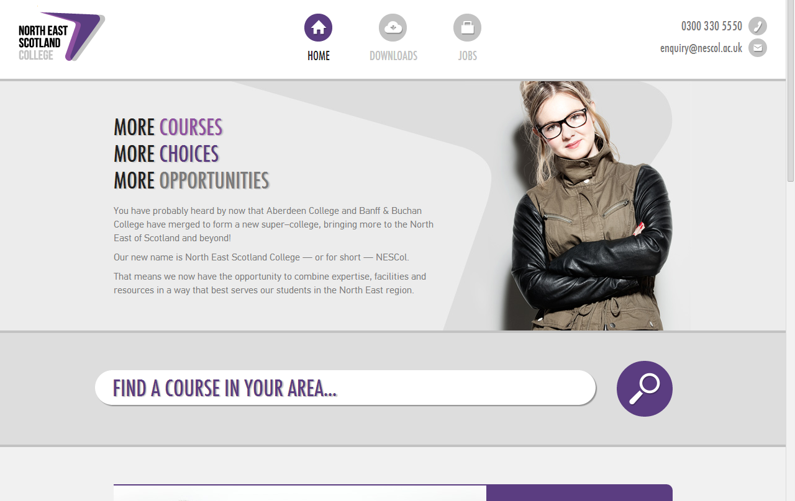
More Information?
If there is anything you need to know about NESCol:
^{Telephone: 0300 330 5550}
Information & Advice: 01224 612284
^{Email: enquiry@nescol.ac.uk}
^{Web: www.nescol.ac.uk}
www.facebook.com/NESCollege
www.twitter.com/NESCollege

